Slide 1

The Black Paper
Professor Godfred A. Bokpin
BSc Admin (Accounting), MPhil (Finance), PhD (Economics)
gabokpin@ug.edu.gh

Slide 2
PRESENTATION OUTLINE
Introduction and Context
The Colonial Economic Legacy
Debt and Trade Slavery
Inequality and Women’s Empowerment
Natural Resource Governance and IFFs

Slide 3
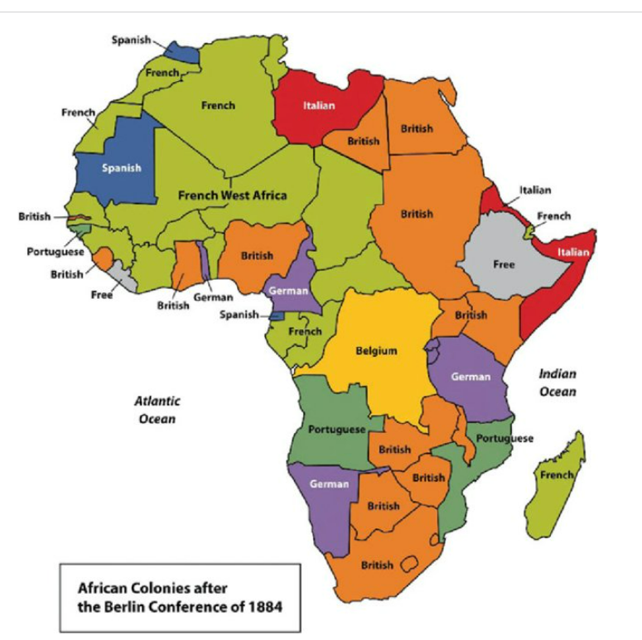
African Geopolitics linked to Colonization

Slide 4
Colonialism and Africa
The geolocation of Africa has not changed, but its geopolitical and geostrategic behaviour has evolved from period to period
Africa’s geopolitics is driven by natural resources, the legacy of colonialism, and the growing influence of both traditional and emerging global powers
Africa is still stuck with colonial legacies
Legal framework and investment shaped by colonization legacies
Internal geopolitics is rife: Rwanda and the DRC

Slide 5
The Colonial Economic Structure
The socioeconomic structure through colonial dominance, exploitation, and imperialism between 1800-1960 was evidenced by:
Cheap labor: Enslavement of Africans and their shipment as cargo out of the continent & Crowded Labor reserves
Cheap Raw Materials: Precious Minerals, Palm kernel etc
Market Opportunities and for dumping: New products were produced faster than their populations could dispose of.

Slide 6
Impact of Colonialism on Africa
Political dominance/conquest: The scramble for and partition of Africa among seven European colonial powers (Belgium, Britain, France, Germany, Italy, Spain, and Portugal) and their resources (both natural and human) weakened African culture, leadership, and governance system
The Exploitation of African Labor: Africans worked as slaves overseas with no reward, denying the continent remittances for development
Reorientation of the African Economy: Food/self-sufficiency to food /economic dependence

Slide 7
Perceived Benefit of Colonialism to Africa
Economic Infrastructure such as railways, bridges, roads, and deep-water ports to connect Africa to them and not Africa to Africa
Exposure to Higher Education:
African middlemen also profited from both the slave trade and other tradable products.
Most African countries experienced rising incomes during the colonial period, relative to the base year of 1885.
Deeper integration of Africa into world trade and World Economy.

Slide 8
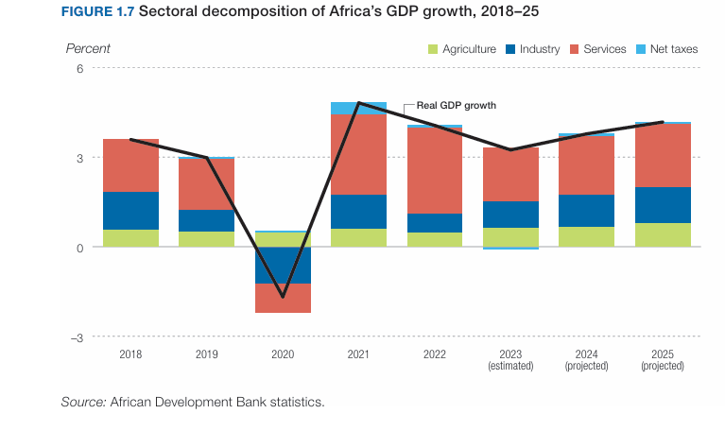
Post-Colonial Economic Structure:1960 to date

Slide 9
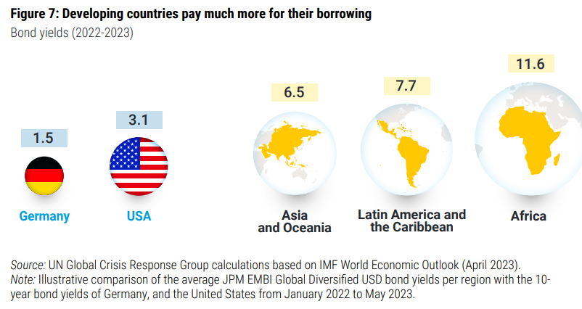
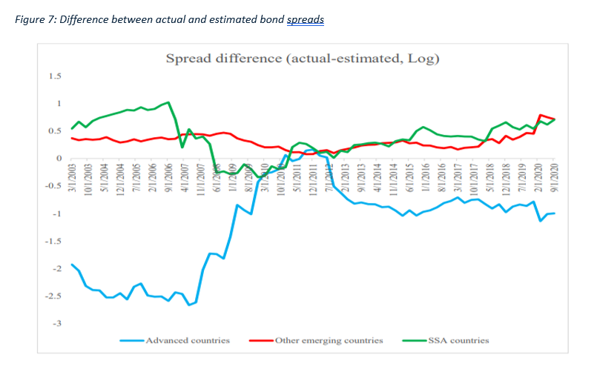
Debt Slavery and New Entrants
Rating Bias and Risk Premium
Higher Costs of borrowing

Slide 10
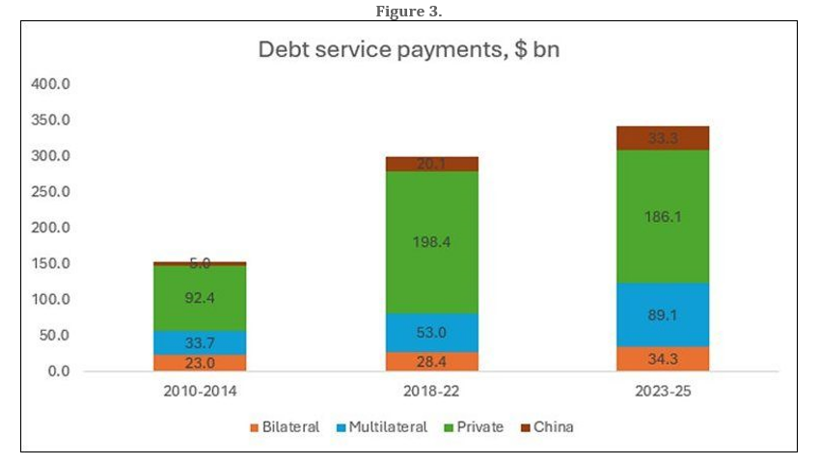
Debt service Implications (IDEAS, 2024)

Slide 11
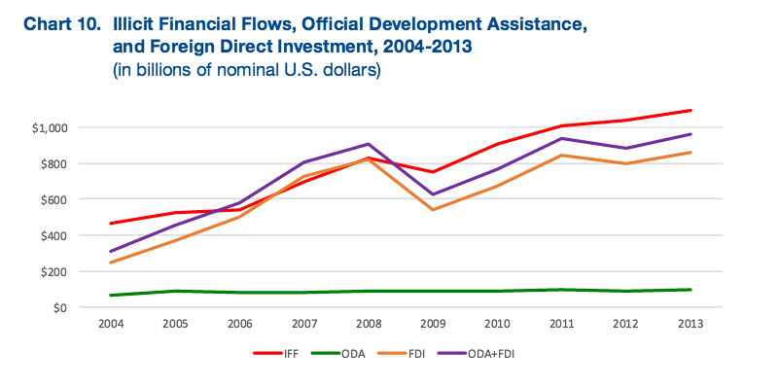
Africa; Net Creditor to the World

Slide 12
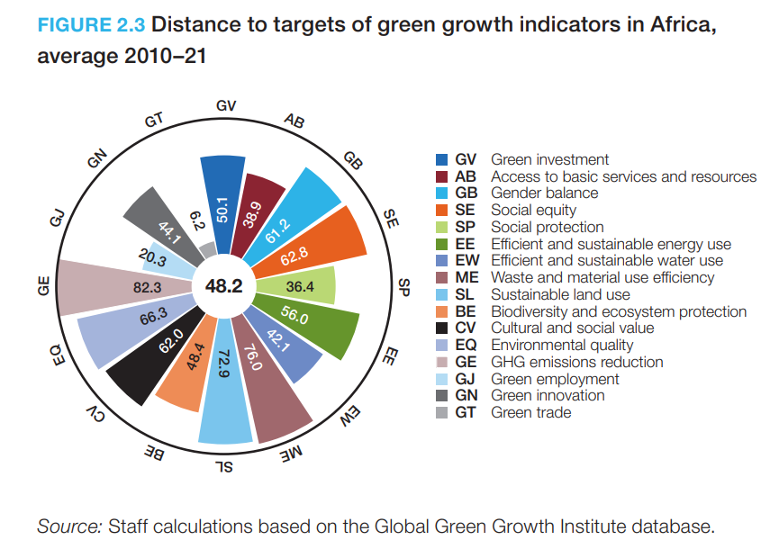
Climate Change and Digitisation (AfDB, 2023)
Africa has great potential and self-interest to achieve green growth.
Africa needs USD 213.4 billion annually to close the climate financing
Africa received USD 4.2 billion in private climate finance in 2019/2020, 14 percent of total climate finance flows of USD 29.5 billion. It requires USD 242.4 billion a year on average until 2030—USD 2.7 trillion over 2020–30—to implement its climate action expressed in the latest submitted Nationally Determined Contributions (NDCs).
Africa needs USD 1.3 trillion annually to meet its sustainable development needs by 2030 and deliver green growth

Slide 13
Colonial Economic Legacy and Women’s Empowerment
“African colonialism generally eroded women's political power and economic autonomy, introducing male-centric legal systems, restricting women's access to resources, and imposing new gender roles”
Leftovers:
Economic Disempowerment
Loss of Political Influence
Imposed Patriarchal Structures
Exacerbated pre-existing barriers

Slide 14
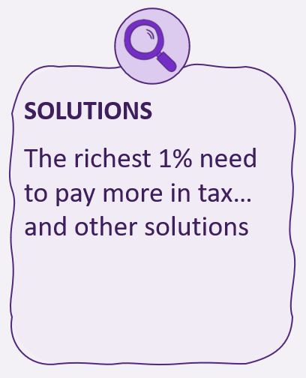
AFRICAN TAX SYSTEMS FUEL INEQUALITY
For every US$1 African countries collect from personal income tax and wealth taxes, nearly US$3 is on average raised from inequality increasing indirect taxes (VAT etc.)
Taxes on wealth have fallen by nearly a quarter since 2012 while payrolls taxes and VAT have increased

Slide 15
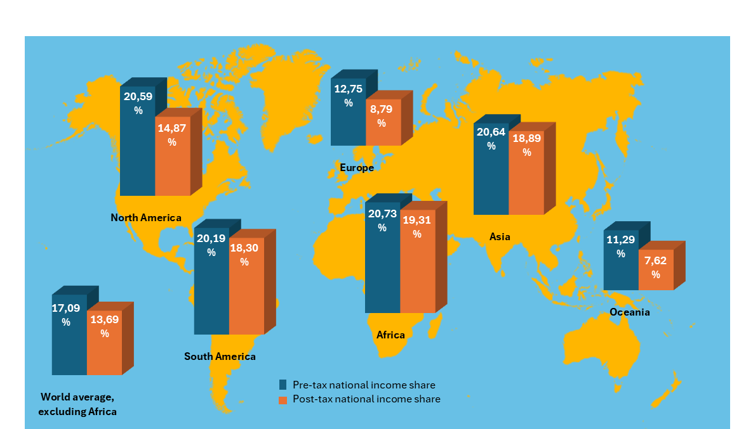
AFRICAN TAX SYSTEMS FAIL TO TAX THE TOP 1%
African countries on average reduce the income of the richest 1% the least through their tax systems
Africa’s tax systems are nearly three times less effective at redistributing income away from the richest 1% than the global average.
Income share of the richest 1%, before and after taxes

Slide 16
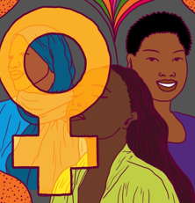
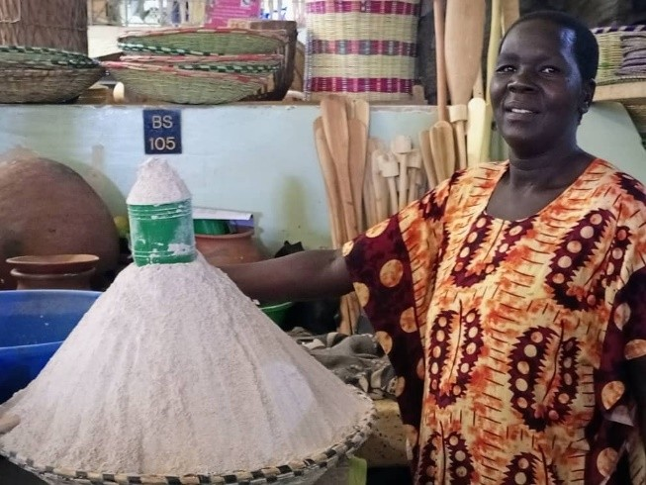
GENDER INEQUALITY
In Africa, men own three times more wealth than women, the highest compared to other regions, and two times higher than the world ratio.
In Uganda, Aber Christine pays 44% in tax on her income from selling a mix of flour. Meanwhile, multinational corporations in Uganda pay a maximum rate of corporate income tax of 30%.
Notes:
On bullet 1: Men benefit more from lower taxes on wealth than women
On bullet 2: When governments relies on indirect taxes and focus more on making the informal sector pay than the rich and corporations it hurts women more than men
This is what we write about Aber Christine and the Gender/Tax link in the report:
Box 5: Regressive taxes are a gender injustice
Aber Christine sells a mix of millet flour, rice and soya used for making porridge at her market stall in Northern Uganda. In a good month she makes a profit of around 300,000 Ugandan Shillings (US$80). She does not pay any income tax, but she does pay market dues collected by the local government of 4,000 Ugandan Shillings a day, plus a market stall rent of 13,000 per month. This means that she pays around 44% of her profits in tax. This is significantly higher than the maximum of 30% corporate income tax that multinational corporations are subject to, highlighting the injustice and regressive nature of tax systems found in many African countries.
Aber Christine also reminds us of another important lesson: the current regressive tax system in many African countries has significant gender inequality built into it. Some of the continent’s richest people and multinational corporations do not pay their fair share, predominantly benefiting men, while market traders such as Aber Christine and other groups – predominantly women, in many cases – tend to pay a higher share due to high indirect and direct taxes. Tax policies and budgets don’t have to be gender blind. Through Oxfam’s Fiscal Justice for Women and Girls project, Christine is a community mobilizer and tries to make local budgets and tax policies address the ingrained gender inequalities that women and girls face.

Slide 17
Recommendations
Strengthen Natural Resource Governance and Fiscal Regime
Transition from environmentally destructive growth model to idea-generation economy
Advance progressive taxation (HNWIs)
Efficient and Progressive Social spending
Leverage AfCFTA
Pursue Economic and financial integration in Africa
Curb Illicit Financial Flows
Engage in restructuring of the global financial system

