Slide 1
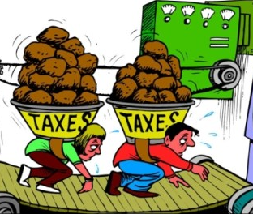
Tax VS Debt servicing in African countries and its implications on citizens
Diana Mochoge - Policy and Advocacy Officer (Domestic Resource Mobilization)
ThePhoto by PhotoAuthor is licensed under CCYYSA.

Slide 2
General view in Africa
According to AFRI Exim Bank, Africa’s debt service-to-revenue ratio remains a significant concern for fiscal sustainability, with many economies far exceeding the IMF World Bank Debt Sustainability Framework (DSF) threshold of 20%. Since 2015, this metric has had a clear upward trend, with the continent’s average debt service burden increasing steadily each year. In 2023, the average debt service-to-revenue ratio was approximately 30%. Although projections for 2024 and 2025 suggest a slight moderation, the average will remain above the DSF threshold, indicating ongoing liquidity stress and fiscal rigidity in numerous African nations.
At least 25 countries exceed the 20% threshold, with a group of high-risk countries—including Mozambique, Ghana, and Zambia—reporting ratios above 50%. In Mozambique’s case, the ratio exceeds 120%, signifying that the government is spending more on debt service than it generates in total annual revenue, which poses a severe solvency risk. By contrast, countries like Rwanda and Botswana remain below the 20% threshold, reflecting more sustainable debt service dynamics. These high ratios mean that a substantial portion of national budgets is allocated to interest and principal repayments, severely limiting the ability to invest in social programs or stimulate economic growth. Consequently, governments are managing fiscal trade-offs that affect investment in social services.

Slide 3
Cont'd
Debt servicing and taxation are competing forces for government budgets in African countries, with heavy debt burdens often consuming a large share of tax revenue and reducing funds for social services eg debt service exceeded 50% of tax revenue in countries like Angola, Kenya, Malawi, Rwanda, Uganda, and Zambia. Even after debt relief measures, Zambia will still be paying two-thirds of its budget on debt servicing between 2024 and 2026 (UN AIDS). The situation is exacerbated by factors like low tax collection and external shocks that lead to higher borrowing and debt service costs.
This forces governments to make difficult decisions, resulting in cuts to social spending, increased taxes, which has dire negative consequences for the population leading to increased inequality margins (Nexus between Tax, Public Debt and Inequality, AFRODAD 2020)
The primary conflict is that money used for debt repayment cannot be used for public services like health, education, and social protection hence debt servicing crowds out social spending
External shocks like the COVID-19 pandemic or commodity price drops (e.g., Zambia's copper price fall) decreases tax revenue and force countries to borrow more, further increasing the debt service burden.
High debt burden again leads to government pressure to raise taxes, sometimes resorting to less progressive taxes, which disproportionately affects low-income households(African Debt Outlook, Afreximbank 2025)

Slide 4
Statistics of debt servicing margins in Africa
Debt servicing in Africa has surged, with a significant rise in the proportion of government expenditure dedicated to debt rising from 3% in 2009 to 10% in 2023, while the average tax-to-GDP ratio has remained low at approximately 16%. This creates a substantial gap where the burden of debt repayment is high relative to the revenue generated.
The high and growing debt service burden in Africa is a concern, especially since tax revenue collection is significantly lower than in other regions at 16% compared to the OECD average of 34%( UNCTAD 2023)
Countries like Angola are extreme cases where debt servicing peaked to 61% of government expenditure in 2021. In 2023, the external debt-to-GDP ratio for Africa was 24.5% with at least 20 low-income countries at risk of debt distress representing 57% of all African countries.

Slide 5
How much are African countries losing to debt servicing?
African countries are projected to pay $88.7 billion in external debt servicing in 2025, which represents a significant portion of government revenues and export earnings. High debt burdens are particularly evident in countries like Nigeria, where debt servicing consumed over 60% of government revenue in 2019, and Kenya, which had a debt servicing to revenue ratio of 67.1% as of May 2024.
Debt servicing consumed 16.7% of African government revenues and 14.8% of African export earnings in 2023 (ActionAid 2025)
In 2019, Nigeria's debt service to revenue ratio was over 60%, meaning it spent over half of its revenue on debt servicing. Debt servicing payments increased by 68% to 13 trillion Nigerian Naira in 2025.
As of May 2024, Kenya's debt service to revenue ratio was 67.1%.
Zambia became the first African country to default on its sovereign debt in November 2020. Its debt to GNI ratio rose dramatically to 168% by 2020, up from 24.9% in 2013.
Ghana spent GH¢189 billion on debt servicing between 2010 and 2022, with 81% of that amount paid between 2017 and 2022 (AfriCatalyst 2025)

Slide 6
Country examples- Implications on citizens
Zambia experienced a default on its $42.5 million Eurobonds in 2020 due to a combination of high debt levels, the COVID-19 pandemic and a drop in copper prices, which is a major source of its revenue.
High debt servicing costs limited the government's ability to allocate funds to crucial sectors like healthcare, education, and social welfare programs. This directly impacted citizens' access to essential services.
A period of economic instability ensued, which can lead to inflationary pressures eroding the purchasing power of citizens' incomes and savings, making basic goods and services more expensive(Zambia's Debt Profile, AFRODAD 2022)

Slide 7
Country examples- Implications on citizens
In Nigeria Nigeria’s debt stock has intensified to concerning heights, with forecasts suggesting that the nation’s overall debt could reach N187.79 trillion by the end of 2025. This scenario has arisen from a complex combination of factors, including extensive borrowing practices, currency devaluation, and inadequate financial governance.
Consequently, over 80% of government revenue is now allocated to servicing debts, leaving minimal funds for essential services like health and education. The rising interest rates have held the country’s debt servicing in a chokehold.
Interest rates worldwide have risen, putting additional pressure on Nigeria’s capacity to handle its debt responsibly. The surge in borrowing costs has made it increasingly difficult for the government to meet its financial commitments without taking on more debt.

Slide 8
Country examples- Implications on citizens
Zimbabwe's high debt servicing burden crowds out government spending on essential services which are primarily funded through taxation. This leaves citizens with poor public services, and the need to generate revenue domestically through taxes is crucial for escaping dependency on foreign aid and debt
A significant portion of the national budget is diverted to debt servicing, leaving less money for critical sectors like health, education, and water/sanitation. This results in a decline in the quality and availability of these essential services for the average citizen.
The strain on public resources due to debt servicing undermines the government's ability to fulfil its human rights obligations thus contributing to the rising inequality margins (Social and Economic Implications of Public Debt on Youths in Zimbabwe, ZIMCODD 2020)

Slide 9
The debt overhang has led to a "debt overhang" effect, where the country's huge debt obligations hinder new investment and economic growth, limiting job creation and making it harder for people to find employment and provide for themselves.
As the government looks to cover its expenses, the burden often falls on citizens through various taxes eg Value Added Tax (VAT) and Pay As You Earn (PAYE) totals 50% of government revenue whereas corporate is just 15%.(Afrobarometer 2021)
Women often bear a disproportionate burden of the negative social effects of public debt. For example, in the absence of adequate public services like clean water and sanitation, they are often forced to spend more time on unpaid care work providing for families( Debt Justice and Gender Justice in Zimbabwe, ZIMCODD 2020)

Slide 10
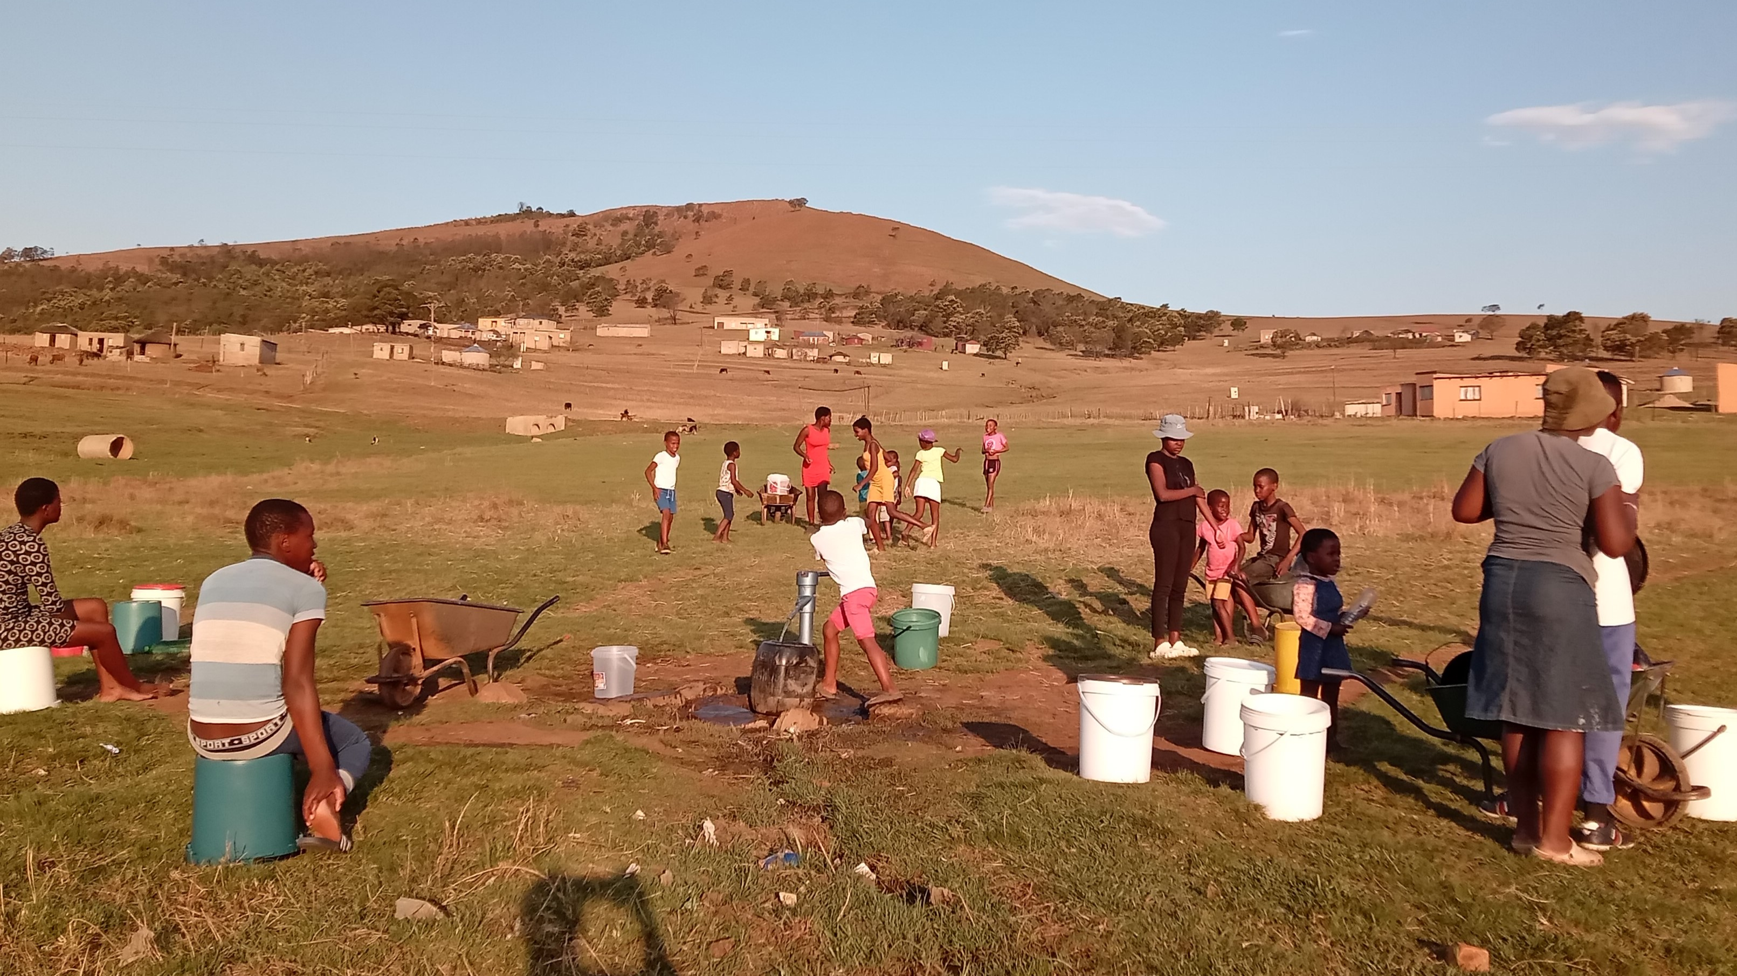
ThePhoto by PhotoAuthor is licensed under CCYYSA.

Slide 11
IMPLICATIONS ON TAX VS DEBT ON CITIZENS- KENYAN CASE
Recently, there was a significant public backlash in Nairobi, Kenya, against the Finance Bill 2024. This bill, which was introduced by President Ruto amidst IMF pressure, aimed to generate US$2.7 billion in tax revenue for the upcoming fiscal year (2025) as part of the IMF revenue targets
The proposed measures disproportionately impacted the working class and rural residents, leading to widespread opposition. The bill’s focus on these demographics sparked controversy and concern among many Kenyans who felt the burden of increased taxes fell unfairly on them. The proposed legislation included increases in consumption taxes, such as:
16% VAT on bread,
2.5% motor vehicle tax
25% excise duty on cooking oil
Eco-levy on environmentally harmful products like diapers, batteries, rubber tires, television sets, and smartphones
Additionally, the legislation imposed an excise duty on locally assembled motorbikes

Slide 12
The impact of these measures was significant because the VAT on essential sectors such as food and transport made essential goods more expensive amidst rising inflation( AfronomicsLaw)
Consequently, widespread peaceful protests led by Generation Z citizens (the Gen Z Revolution) occurred, however, the militarized intervention of state security forces quickly escalated the peaceful protest, leading to the loss of lives and properties.

Slide 13
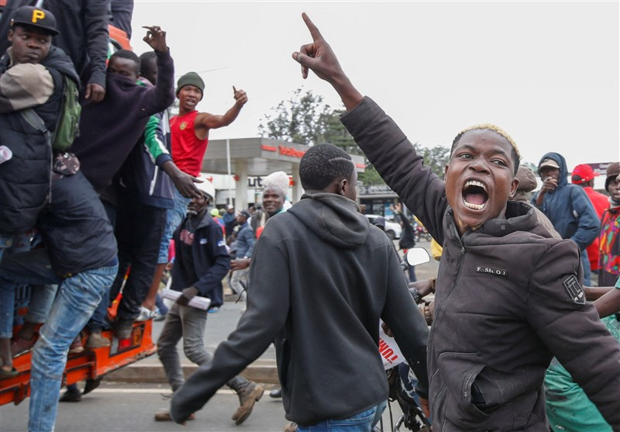
Gen z revolution in Kenya
ThePhoto by PhotoAuthor is licensed under CCYYSA.

Slide 14
Recommendations
From the Harare declaration (adopted 21st August 2021)
Urges Governments to work with their National Legislatures to strengthen national legal frameworks to ensure transparency and accountability for sovereign debts negotiations, borrowing and management as espoused in the African Borrowing Charter. Urge the African Union to strengthen collective learning and coordination around debt negotiation outcomes, including on interest rates, grace periods, and environmental, labour and other clauses that affect African lives.
Look at introducing legislation to ringfence budgets for social protection

Slide 15
THANK YOU

