Slide 1
Role of Parliamentarians in Advancing Responsible Debt Governance
Catherine Mithia
Policy officer, sovereign debt management
African Forum and Network on Debt and Development (AFRODAD)
www.afrodad.org

Slide 2
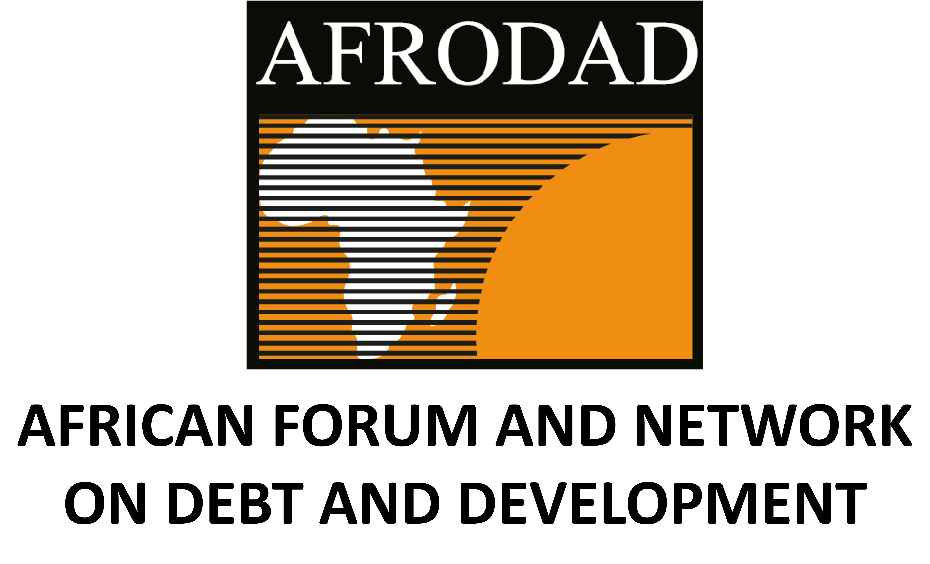
Presentation Outline
Pt 1 – Understand Africa’s Debt Landscape
Pt 2 – Explore AFRODAD’s Harare Declaration
Pt 3 – Understanding the Africa Borrowing Charter
Pt 4 – Mps Role in streghtening debt governance

Slide 3
Part 1 – Africa’s Debt Landscape

Slide 4
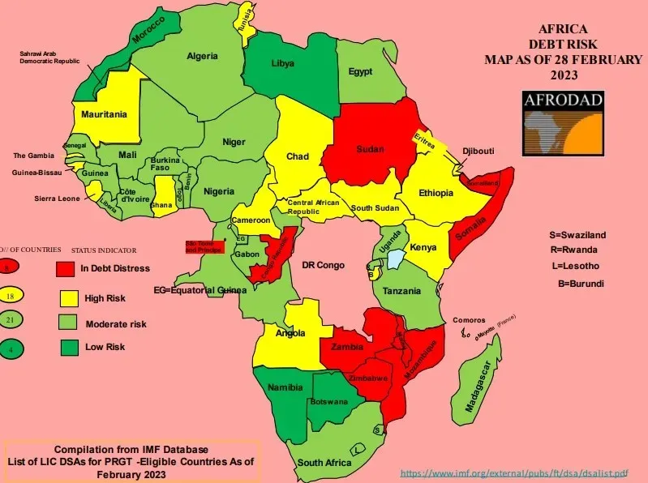
Africa’s Debt Levels

Slide 5
Key Terminologies in Africa’s Debt Crisis
Debt Finance
Foreign Debt
Domestic Debt
Debt Service + Debt Interest Service
Principal + Interest
Debt to GDP Ratio
Debt Service to Tax Revenue Ratio
Sovereign Bond
Treasury Bills
Eurobonds
Debt Restructuring
Debt Reprofiling
Debt Default
Debt Cancellation
Debt Transparency
Debt Swaps
USD Denominated Debt
Notes:
Debt Swap - Debt swaps are agreements between a government and one or more of its creditors to replace existing sovereign debt with one or more liabilities1 that include a spending commitment towards a specific development goal
Eurobond - A Eurobond is a bond issued offshore by governments or corporates denominated in a currency other than that of the issuer's country. Eurobonds are usually long-term debt instruments. Eurobonds are typically denominated in US Dollars (USD)
Odious Debt - "Odious debt" refers to sovereign debt incurred without the consent of the people and used in ways that are demonstrably harmful or detrimental to the nation's interests, potentially justifying non-transferability to a successor government, especially if creditors were aware of these facts. The concept of "odious debt" was developed by legal scholars as a way to address situations where a government, often a despotic or unpopular regime, incurs debt that is used for purposes that are against the interests of the people, and that a successor government might not be obligated to repay.
Debt to GDP Ratio - The debt-to-GDP ratio is a key economic indicator that compares a country's total public debt to its gross domestic product (GDP), expressed as a percentage, to assess its ability to repay its debts. High Debt to GDP Ratio = high debt burden; low debt to gdp ratio = low debt burden
Debt Reprofiling - Debt reprofiling, a voluntary option for heavily indebted countries, involves modifications to the schedule of future repayments by asking creditors for more time, cutting interest payments, or reducing the total amount owed, essentially buying time for the debtor to address economic challenges.
Debt Restructuring - Sovereign debt restructuring is a formal process where a country, facing unsustainable debt levels, exchanges its existing debt instruments (like loans or bonds) for new ones or cash, aiming to reduce the overall debt burden and make repayments more manageable

Slide 6
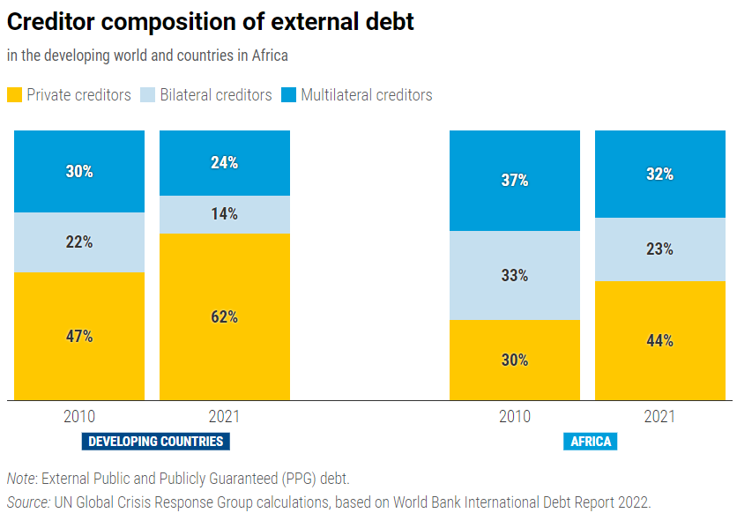
Africa’s Debt: The Creditors
In 2022, public debt in Africa reached USD 1.8 trillion. While this is a fraction of the overall outstanding debt of developing countries, Africa’s debt has increased by 183% since 2010, a rate roughly four times higher than its growth rate of GDP in dollar terms.
The structure of African debt has changed considerably. Bilateral debt now represents 23% in 2021 compared 33% in 2010 and 52% in 2000. Private or Commercial debt stood at 44% in 2021up from 30% in 2010 and 20% in 2000
https://unctad.org/publication/world-of-debt/regional-stories

Slide 7
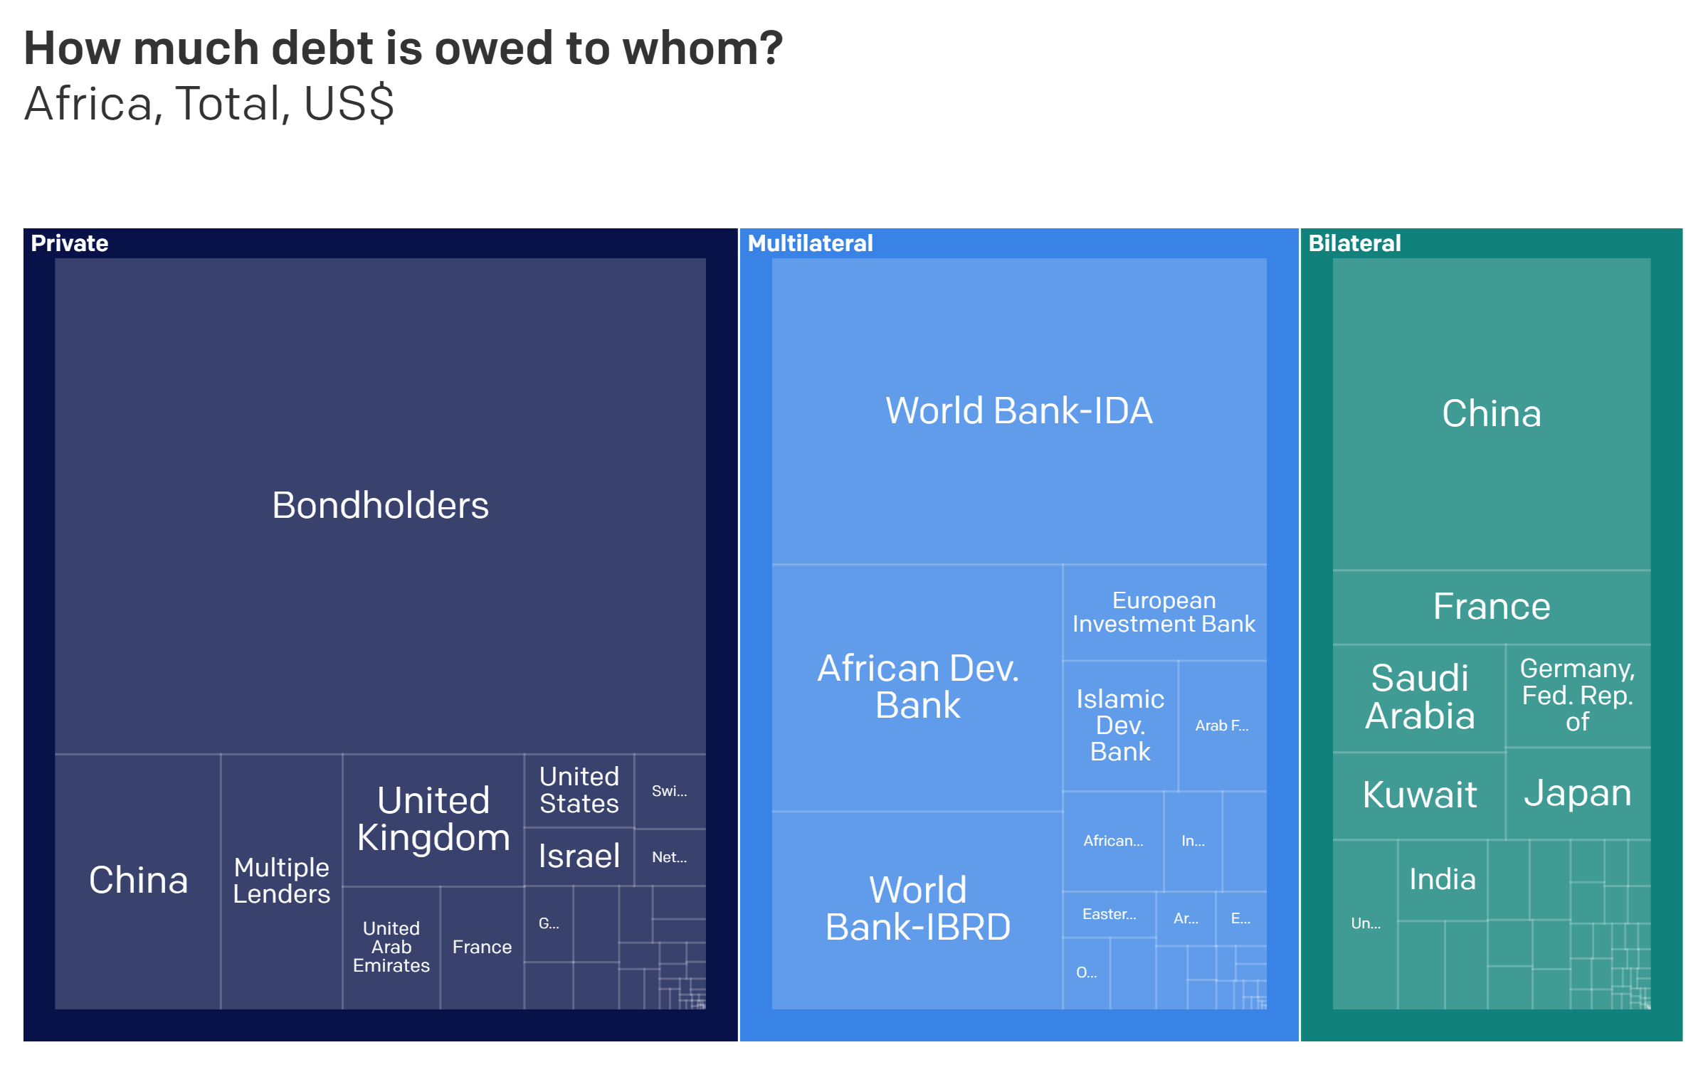
https://data.one.org/analysis/african-debt

Slide 8
Debt Architecture
Borrower e.g.African Government
Instruments
Project Based
Cash
Swaps
Bonds, Bills
PPPs
Lenders
Bilateral -> Old and New
Multilateral -> Old and New
Commercial (Foreign and Domestic)
Governance
IMF
UN (?)
CRA Regulation (?)
Market Signallers
Credit Rating Agencies
IMF
Capital Markets

Slide 9
Part 2 – The Harare Declaration

Slide 10
Political Economy of Africa’s Debt
Harare Declaration inaugurated in 2021, AfCoDD II,political economy framing and response to Africa’s decades of debt crisis
Emphasis: Debt is not just financial; it intersects with development, governance, and human rights.
Key Elements:
1. Historical and Structural Context
2. Debt as a Development and Social issue
3.Debt and Governance
4. Responsibility of Borrowers and Lenders
5.Debt Justice and Sovereignty
Notes:
Africa’s debt is linked to debt is linked to colonial legacies(African economies inherited debt), structural inequalities and economic structures that limit fiscal sovereignty, and unfair global economic systems that perpetuate aysmettric power dynamics in borrowing

Slide 11
Principles from the Harare Declaration
The Harare Declaration besides providing a road map, translates principles into parliamentary practice and equips parlimentarians with a lens to, analyse debt critically, hold governments and lenders accountable and ensure borrowing serves citizen’s development and welfare.
1. By understanding debt is shaped by historical structures, global power relations, and domestic governance, parliamentarians can ask informe questions about terms, conditions and impacts of borrowing.
E.g. Mozambique Hidden Debt Scandal highlights the dangers of bypassing parliamentary oversight: Mps demanded full disclosure of all loan agreement, investigated and debated the scandal and highlighted need for stronger debt oversight and legal frameworks.
ii)Kenya Eurobond Issuances-used for large infrastructure projects, with high interest and limited parliamentary participation. Construction of SGR which is yet to realise returns. arliamentarians questioned the Ministry of Finance, debated appropriateness of interest rates, and highlighted the need for stronger legislative frameworks for external borrowing.
2. The declaration provides clear criteria for distinguishing responsible vs. irresponsible lending, with emphasis on transparency, ethical lending(creditors) and alignment with development goals.
-Parliamentarians must demand full feasibility studies before, debt sustainability analysis and public disclosure before approving new loans-to provide a justification for rejecting or renegotiation loans that are unsustainable or socially harmful
3. Harare declaration provides legal and moral grounding to assert parliamentary authority and empower parliamentarians to institutionalise mechanisms such as regular review of loan contracts, monitoring utlisation of borrowed funds and questioning ministers on debt strategy
Example:Lesotho,2028 Contract with Frazer Solar-Large project(supply for a large solar‑power and related energy supply deal), Frazer-solar claimed breach of agreement, foreign arbitrator awards damages of 50million pounds in favour of Frazer Solar. Govt of Lesotho challenges the deal-lack of proper compliance with national procurement or constitutional financial management laws; specifically, lacking required approvals and oversight.
Notes:
Example Lesotho: Frazer Solar later initiated arbitration, claiming Lesotho breached the agreement. A foreign arbitrator awarded damages of about €50 million in favour of Frazer Solar. The government challenged the contract in Lesotho’s courts, arguing that the agreement was negotiated and signed without proper compliance with national procurement or constitutional financial management laws; specifically, lacking required approvals and oversight.
n a landmark ruling, the High Court of Lesotho declared the contract and associated arbitration agreement invalid — i.e., void ab initio — because of the procedural irregularities and lack of authorization
Lessons: While the contract was pitched as a solar energy deal, the process bypassed safeguards. The Harare Declaration emphasizes that borrowing or financial agreements must align with long‑term development and public welfare. In this case, the deal exposed national finances to legal and fiscal risk instead.
Insist on full parliamentary review and approval for any major contracts or loans — especially those involving foreign companies and long‑term obligations. This ensures democratic oversight before committing state resources.
Require transparency and public disclosure of contract terms, including obligations, arbitration clauses, payment schedules, and termination/penalty clauses. Hidden or opaque deals are more likely to lead to future liabilities.
Carry out debt / liability sustainability and risk assessments before approving contracts: what happens if obligations are defaulted, litigated abroad, or arbitrated? Can the state afford possible damages?
Protect national sovereignty and safeguard long‑term public interest by avoiding deals that put key national assets, revenues, or sovereignty at risk — especially if foreign creditors can enforce awards abroad.

Slide 12
Part 3 – The Africa Borrowing Charter
The African Borrowing Charter is AFRODAD’s is guiding framework developed to promote responsible, transparent and sustainable borrowing by African governments.
It sets standards to ensure that sovereign debt is contracted in ways that protect citizens, uphold accountability, and advance long-term development.
It equips Parliamentarians with standards to guide oversight, lawmaking, accountability, and citizen protection.
Core Principles of the Africa Borrowing Charter
Transparency and Disclosure
Parliamentary oversight
Debt sustainability
Public Participation
Alignment with national and continental development goals

Slide 13
Case Study: Lesotho Draft PDM Bill
Lesotho’s current debt management is governed under the Loans and Guarantees Act-1967-Where the minister has the sole authority to borrow on behalf of the government and to issue guarantees
The government adopted a Medium-Term Debt Strategy (MTDS) in 2018 and a Public Debt Management Policy Framework in 2019. These are meant to guide borrowing, risk management, and medium-term planning
More recently (2024), a Public Debt Management Bill was tabled in Parliament; however there are gaps in instituting parliamentary oversight:
Weaknesses and Gaps
1. Section 6 of the Bill permits foreign borrowing and requires Gazettement, and mandates publication of the medium-term debt management strategy and annual borrowing plan However, There is also no requirement for parliamentary reporting on foreign debt exposure. Comparing to the Africa Borrowing Charter, which recomends“ A loan obtained by government shall be applied solely for the purpose for which it was obtained and in accordance with the terms and conditions under which it was obtained, unless parliament is consulted and votes in favour of applying the funds towards another purpose”
Risk: The absence of exposure caps or risk-mitigation requirements is a significant gap compared to international standards.
Recommendation: Additionally, introduce a requirement for parliamentary reporting on foreign debt exposure to ensure transparency and accountability
2. Sections 11 and 12 of the Bill establish a comprehensive borrowing architecture. However, it centralizes all debt and guarantee powers in one official-the Minister of Finance
Risk: However, this concentration of power raises governance and risk concerns. Without objective criteria or external checks, the potential for political expediency or mission creep is significant—especially given the open-ended list of purposes.
Recommendation: The ABC provides and recommends that Although the power to borrow or guarantee a loan vests in the minister responsible for finance, the minister can only do so if the terms and conditions of the loan are in accordance with standard terms and conditions approved by the National Assembly.

Slide 14
Call to African Parliamentarians
Debt management is highly technical. Without the requisite knowledge and tools, parliamentarians cannot effectively interrogate assumptions or hold officials to account.
They play constitutional role in approving loans, amending PFM and debt laws, provide oversight through budget accounts committees, finance commitees, through public hearings and ensure deporting requirements are adhehered to.
Both the Africa Borrowing Charter and the Harare Declaration provide an African-led framework that empowers Parliamentarians to become central actors in responsible, transparent, and development-driven debt governance.
Call to Parliamentarians:
Insist on transparency and due diligence
Ensure borrowing serves citizens and development
Strengthening legal and institutional Frameworks
Protect national sovereignty from harmful contracts
Democratise debt decision through oversight and citizen engagement

Slide 15
Thank you for your kind attention

