Slide 1
Human Rights-Based Approach to Sovereign Debt Investment Arbitration
17th October 2024
PALU Annual Conference
Addis Ababa, Ethiopia
Afshin Nazir
Legal Analysis and Advocacy Policy Officer
AFRODAD
Validation of Study

Slide 2
Outline
Introduction
Analysis of challenges and risks in the African context
Human Rights Issues in SDIA
HRBA and HRIA
Opportunities
Recommendations

Slide 3
Introduction
Principle of state immunity
The 1970s and 1980s – shift in the doctrine of absolute sovereign immunity to a more restrictive approach.
Distinction between sovereign acts and commercial acts.
The 1990s witnessed a surge in BITs which included arbitration clauses that permitted investors to bring claims directly against states.

Slide 4
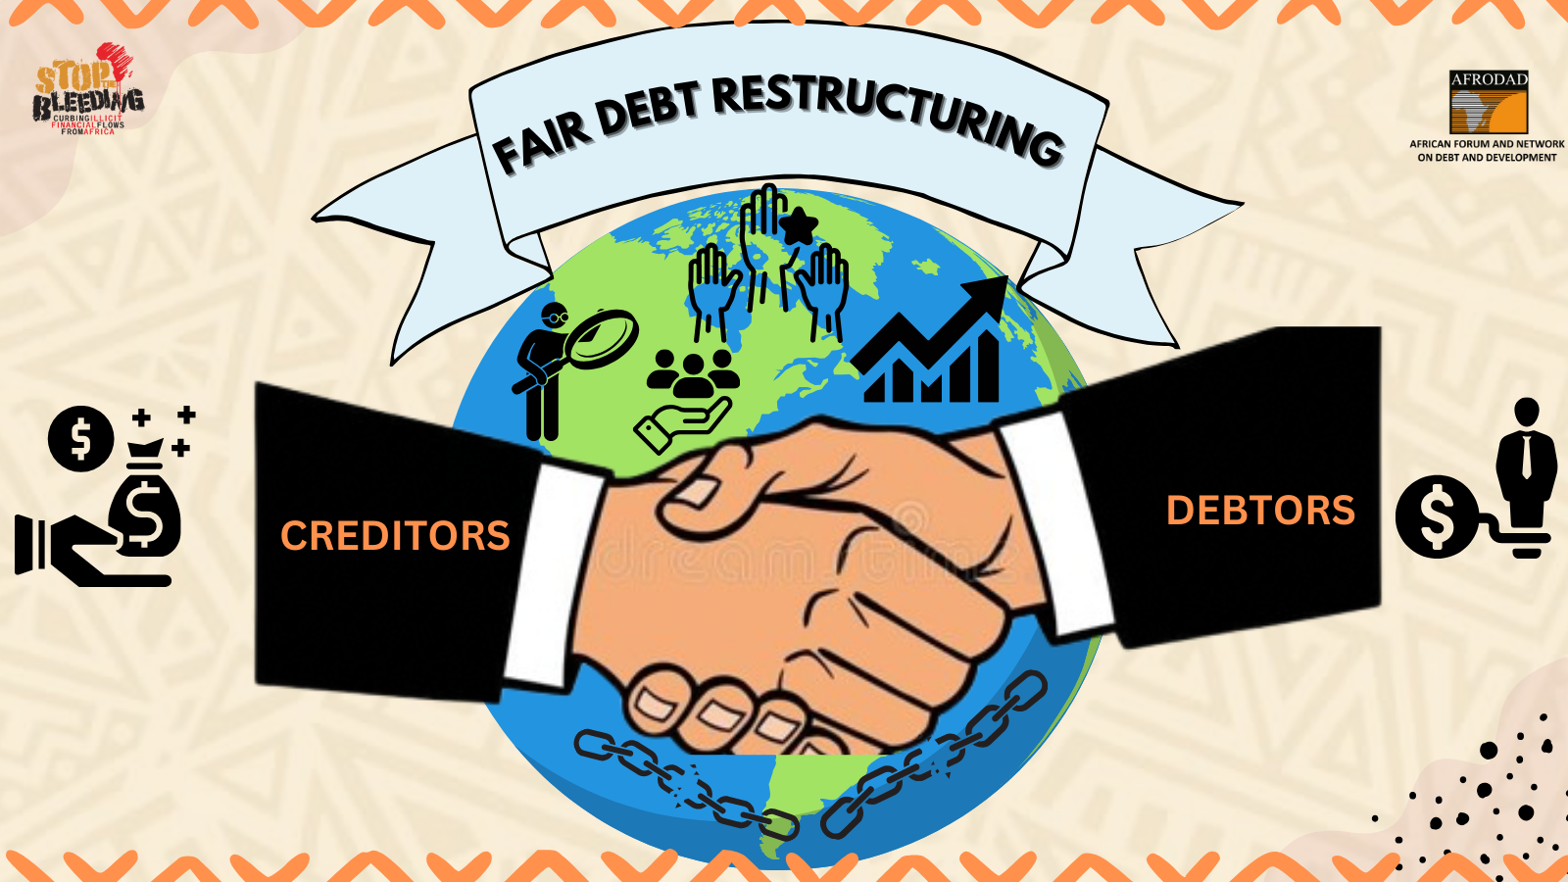
Introduction
SDIA as a trend attributable to the failure by the international community to establish an international legal and institutional framework on sovereign debt restructuring.
Promotes hold out creditors, financial and economic crises.

Slide 5
Introduction
Lack of clarity around the word investment under the ICSID Convention
Art 25 grants jurisdiction with regard to any legal dispute arising directly out of an investment.
Abaclat v Argentina – the term ought to be construed broadly to include sovereign bonds. Also had a dissenting opinion.
Postova Banka v Greece – Tribunal disagreed that Postova Banka’s interests in Greek government bonds qualified as investments under the Slovakia-Greece BIT and the ICSID Convention.
The likelihood of African countries becoming increasingly entrapped in SDIA is influenced by several factors, including the increasing reliance on international capital markets and private creditors.

Slide 6
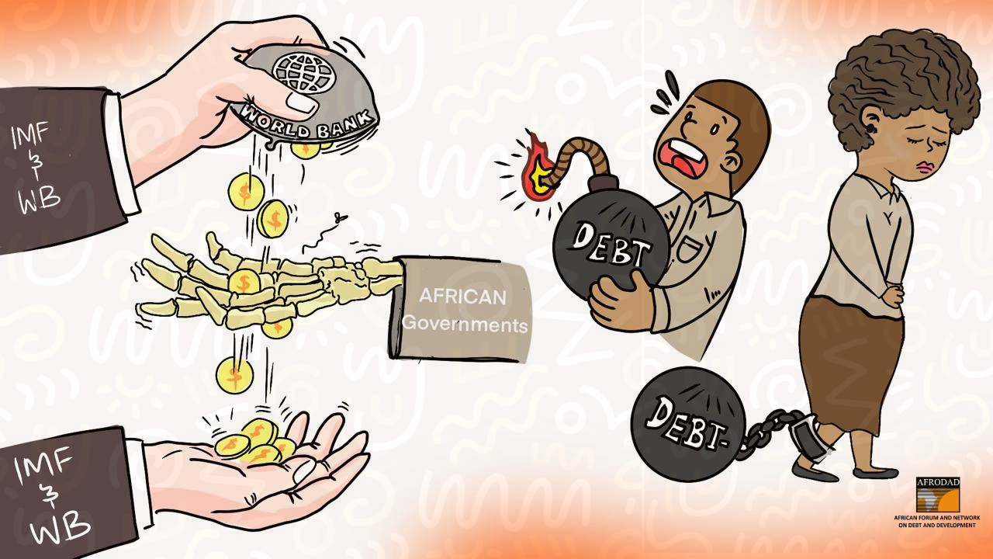
Analysis of Challenges and Risks in the African Context
High debt levels
Limited access to financial markets – smaller pool of lenders with higher interest rates.
Adverse economic conditions – economic conditions, fluctuations in commodity prices, political instability, conditionalities.
Lack of legal and financial resources.
Reputational risks – sovereign bad debtor.
Human rights risks.
Socio-political risks – the case of Argentina.
Feminist lens.

Slide 7

Human Rights Issues in SDIA
Balance between investor protection and human rights considerations.
Austerity measures can affect socio-economic rights.
Disproportionate impact on vulnerable groups.
Inequalities.
Development agenda affected.

Slide 8
Feminist Gendered Analysis in SDIA
Gendered impacts of sovereign debt and economic policies
Gender blindness in arbitration proceedings
Impact of economic policies on gender
Argentina case – austerity measures imposed led to a reduction in social services which increased the unpaid care burden on women, limiting their participation in the formal economy and leading to a decline in women’s employment rates.
Jamaica’s debt crisis in the 2010s also led to severe austerity measures as part of debt restructuring agreements, exacerbating gender inequalities and increasing the unpaid care burden on women.
Financial stress, unemployment, and reduced access to social services can heighten domestic violence. The weakening of social safety nets also limits the resources available to support survivors of gender-based violence.
Underfunding of gender equality policies and programs.

Slide 9
Human Rights Issues in SDIA: Case Studies
Argentine case – Argentina defaulted on its debt and subsequently faced multiple arbitration claims at ICSID. Foreign bondholders argued that Argentina’s debt restructuring measures violated their rights under BITs. The austerity measures led to severe social impacts such as increased poverty, unemployment and a decline in access to essential services.
Ecuador case – Arbitration against Ecuador due to the enforcement of a domestic court judgement against Chevron related to environmental damages. The arbitration tribunal ruled in favour of Chevron, ordering Ecuador to pay substantial damages. This decision prioritised investment rights over Ecuador’s ability to enforce its environmental laws. The case illustrated the conflict between investment rights and environmental and indigenous rights.

Slide 10
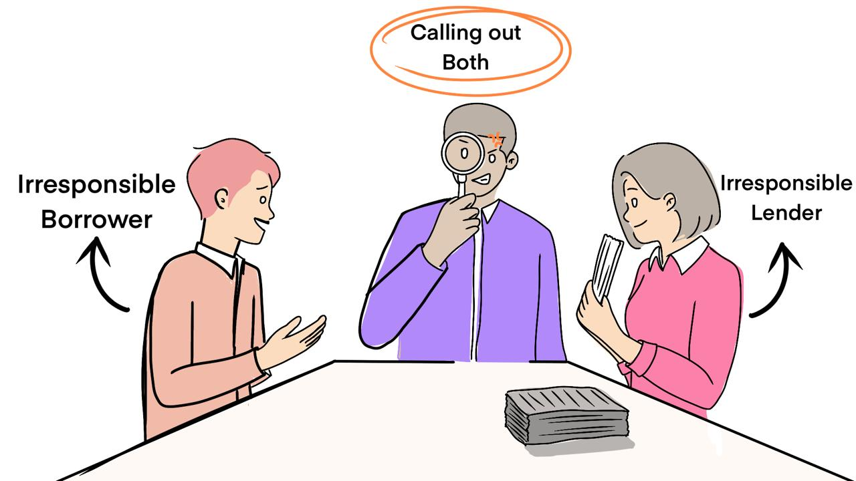
Human Rights-Based Approach in SDIA
Participation – of affected populations in the arbitration process. This also involves ATI.
Accountability – establishing mechanisms to hold both states and investors accountable for their actions.
Non-discrimination and equality – preventing discrimination in the arbitration process and its outcomes.
Empowerment – strengthening the capacity of individuals to understand and claim their rights, and participate effectively in the arbitration process.
Legality – ensuring that all arbitration proceedings and outcomes are consistent with international human rights standards and obligations.
Feminist-gendered analysis

Slide 11
Human Rights Impact Assessment
Objective: The HRIA aims to identify, prevent, and mitigate any adverse human rights impacts arising from sovereign debt arbitration. It also seeks to enhance positive outcomes, ensuring that the process contributes to the fulfilment of human rights.
Process: The HRIA involves a thorough analysis of the human rights context, identifying vulnerable groups, assessing potential impacts, and developing recommendations to address any risks. This process should be participatory, involving input from affected communities, civil society organisations, and human rights experts.
Implementation: Findings from the HRIA should guide the design and execution of arbitration proceedings. This includes adjusting arbitration agreements, modifying debt restructuring proposals, and ensuring that any awarded damages do not undermine the state’s ability to meet its human rights commitments.

Slide 12

Design and Implementation of a HRIA
Integrating HR provisions in legal frameworks
Drafting and negotiation – incorporating explicit HR considerations in investment treaties.
Training and capacity building – providing training for legal practitioners, arbitrators, government officials on human rights law and its application in investment arbitration.
Conducting a HRIA prior to arbitration to identify potential HR risks associated with the proceedings.
Continuous monitoring should continue during the arbitration proceedings.
Public participation is crucial.

Slide 13
Design and Implementation of a HRIA
Implementing findings and recommendations
The results of the HRIA should inform the arbitration process.
Post-arbitration measures should be implemented including adopting policies and programs to mitigate any adverse HR impacts identified during the process.
Creating accountability mechanisms
Review and redress – Monitor the HR impacts of arbitration awards and provide redress for any violations.
International cooperation – can provide additional oversight e.g. through the UN.

Slide 14
HRIA: Potential Challenges
Resistance from arbitrators and investors
HRBA and HRIA require significant resources
Striking a balance between investor rights and human rights requires careful negotiation and compromise.

Slide 15
Any Opportunities?
Development of precedents favourable to sovereign states
Enhancing legal and institutional capacity
Promoting stronger transparency and accountability in debt management
Negotiating more favourable debt terms
Contributing to global discourse on sovereign debt and development
Leveraging arbitration for economic and financial innovation

Slide 16

Recommendations
Integrating gender perspectives and strengthening human rights in debt and investment policies and agreements
Enhance public participation and transparency in debt and investment decisions.
Incorporate human rights and gender considerations into debt practices for creditors.
International legal framework for promoting human rights and gender equality in international debt and investment practices.

Slide 17
Thank you for your attention. Any feedback on the paper?

